Slide 1
Gala Event
Blockchain Challenge 2022 @University of Basel
Team
CSAM
11 May 2022

Slide 2
Our Team
Lena Mourad
Tunç Polat
Severin Plüss
Student MA Economics University of Zurich
Student MSc Business & Technology University of Basel
Student BSc Business Information Technology FHNW

Slide 3
We created a marketplace for tokenized closed-end fund shares.

Slide 4
What are Closed-End Funds?
Portfolio Manager
Qualified Investor
Qualified Investor
4

Slide 5
What are Closed-End Funds?
Portfolio Manager
Qualified Investor
Qualified Investor
4

Slide 6
What are Closed-End Funds?
Portfolio Manager
Qualified Investor
Qualified Investor

Slide 7
What are Closed-End Funds?
Portfolio Manager
Qualified Investor
Qualified Investor

Slide 8
What happens when a qualified investor wants to sell shares?
Qualified Investor
Qualified Investor
5

Slide 9
Process based on an excel waiting list and without a pricing mechanism, causing substantial admin effort.
Waiting List
Alice
Qualified Investor
Bob
Claudia
6

Slide 10
Problems to Solve
01
02
03
Finding Investment Opportunities
Transferring Shares
Pricing Mechanism
Transferring shares takes much effort for the portfolio manager.
In the process of transferring shares, there is no price mechanism.
Finding real estate investment opportunity without diluting investment performance.
7

Slide 11
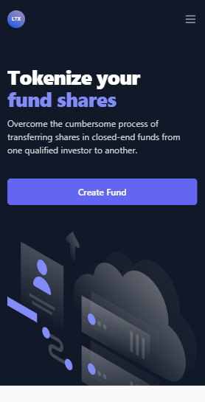
How we solve it
Blockchain-based Marketplace
Tokenization
Waiting List vs. Dutch Auction
Corporate Actions
8

Slide 12
How we solve it
Blockchain-based Marketplace
Tokenization
Waiting List vs. Dutch Auction
Price
Starting Price
Alice
Bob
Bobs Bid
Claudia
Min. Price
Time
End of Auction
Max. Duration

Slide 13
How we solve it
Blockchain-based Marketplace
Tokenization
Waiting List vs. Dutch Auction
Corporate Actions
8

Slide 14
Blockchain will help us to solve the problems we addressed before.
Even tough a traditional database could too.
Transparency
Verifiable
DeFi
9

Slide 15
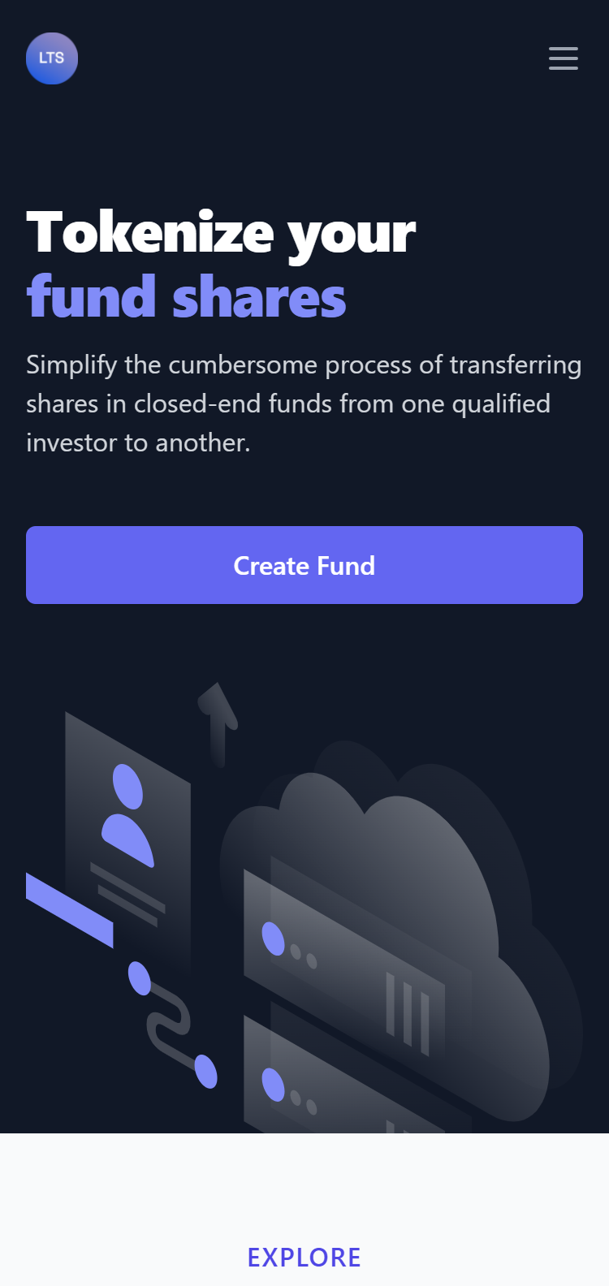
Web Application
Create Fund
Portfolio Manager
Title & Description
Price Mechanism
Minting
White-Listing
https://cef-marketplace.vercel.app
10

Slide 16
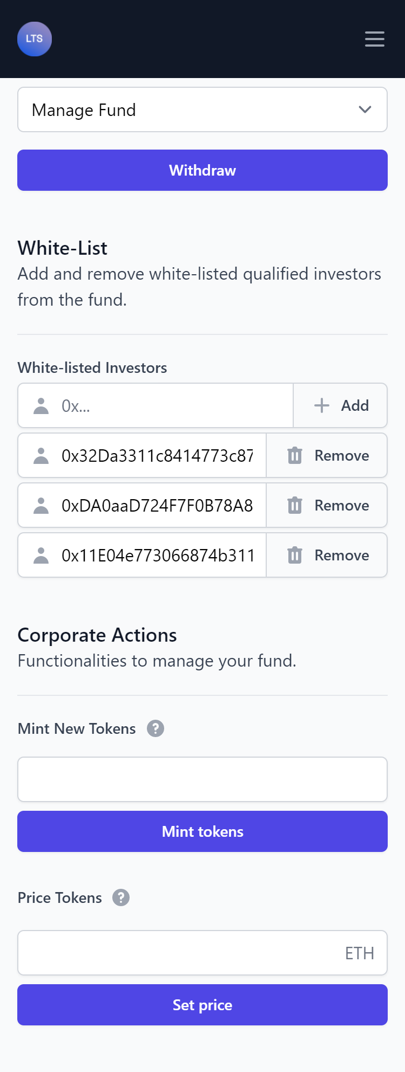
Web Application
Manage Fund
Portfolio Manager
Withdraw
Add & Remove Qualified Investors
Corporate Actions
https://cef-marketplace.vercel.app
11

Slide 17
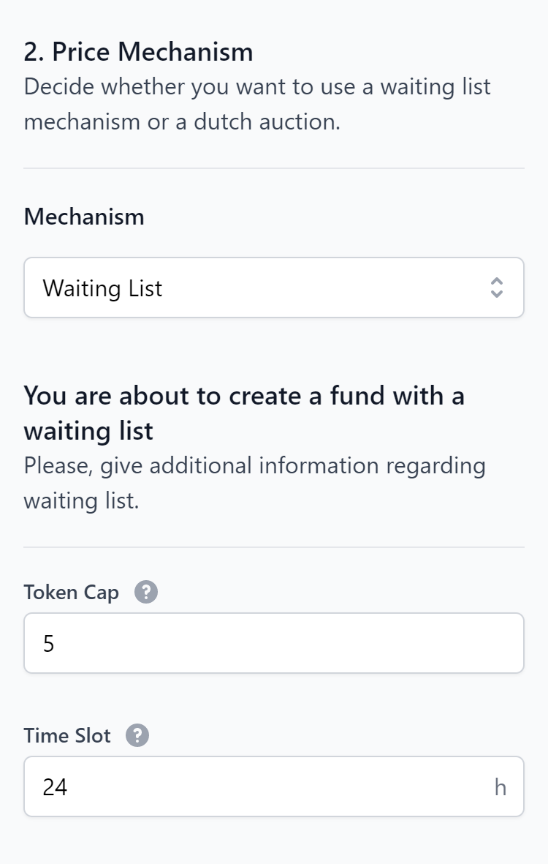
Web Application
...with a Waiting List
Token Cap
Time Slot
https://cef-marketplace.vercel.app

Slide 18
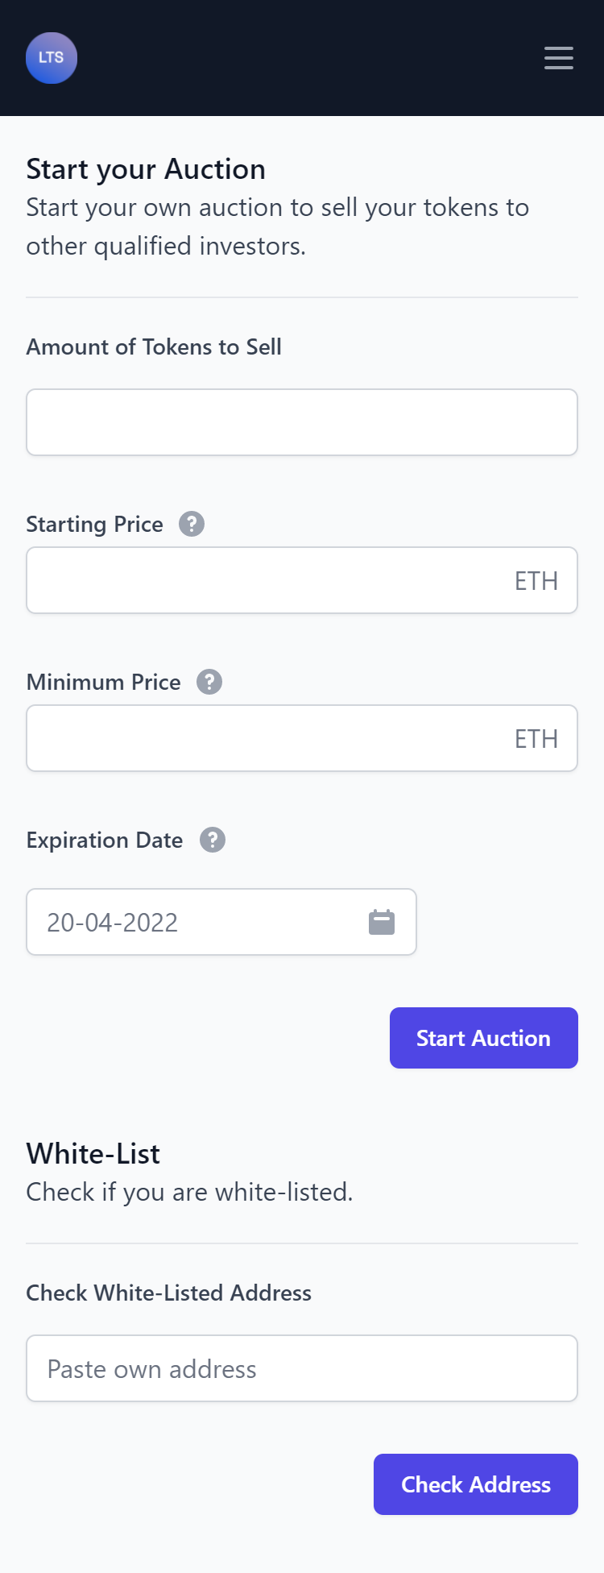
Web Application
Manage Investment Qualified Investor
Check Balance
Buy Tokens
Sell Tokens
Check White-List
https://cef-marketplace.vercel.app
13

Slide 19
Web Application
…with a Waiting List
Buy Tokens
Sell Tokens
https://cef-marketplace.vercel.app
14

Slide 20
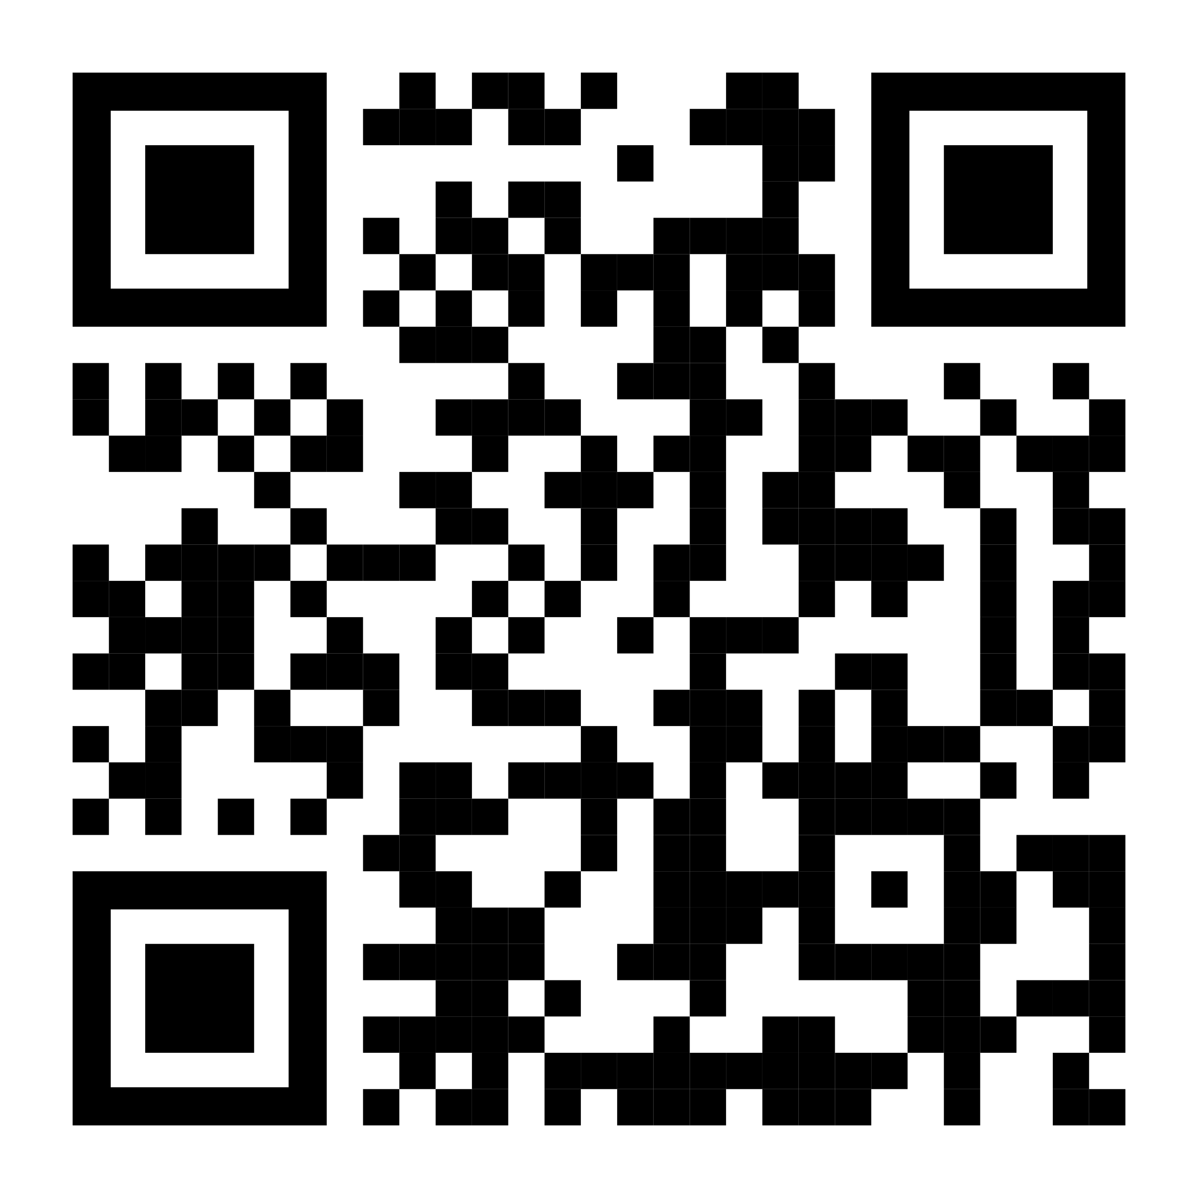
https://cef-marketplace.vercel.app

