Slide 1
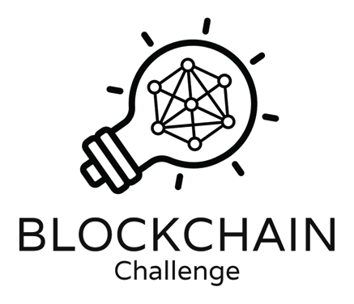
Trading Cards
Oracle Based Dynamic NFTs
A presention by DYNAMICON

Slide 2
DYNAMICON Team
2
Carlo Seppi
PhD cand. Biomedical Ing.
University of Basel
Jonas Ruchti
BA cand. Business & Economics
University of Basel
Kai Bajka
Cand. MLaw
University of Basel

Slide 3
Traditional Panini Trading Cards
3

Slide 4
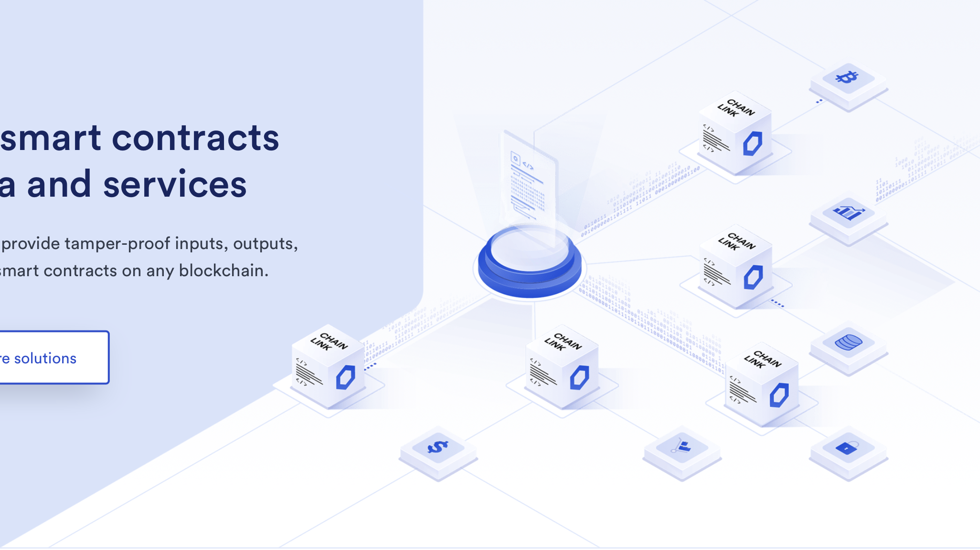
4
What is Chainlink?
A short overview.
Chainlink decentralized oracle networks provide tamper-proof inputs, outputs, and computations to support advanced smart contracts on any blockchain.
Notes:
Source: https://www.google.com/url?sa=i&url=https%3A%2F%2Fblog.chain.link%2Fwhat-is-chainlink%2F&psig=AOvVaw3hNYNkCFFcnjsEHd_CTNTj&ust=1651559980942000&source=images&cd=vfe&ved=0CAwQjRxqFwoTCODlhMKawPcCFQAAAAAdAAAAABAK

Slide 5
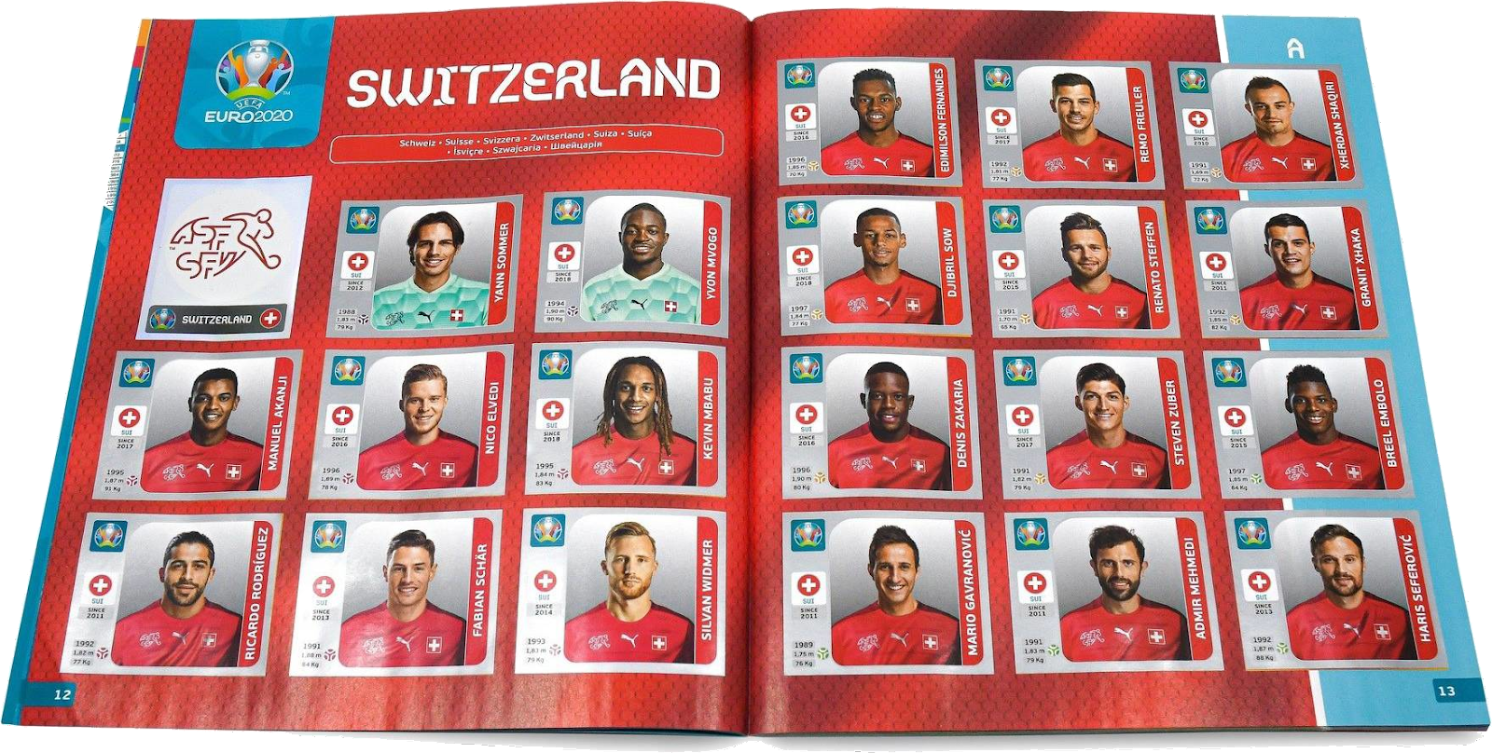
Traditional Panini Trading Cards
5

Slide 6
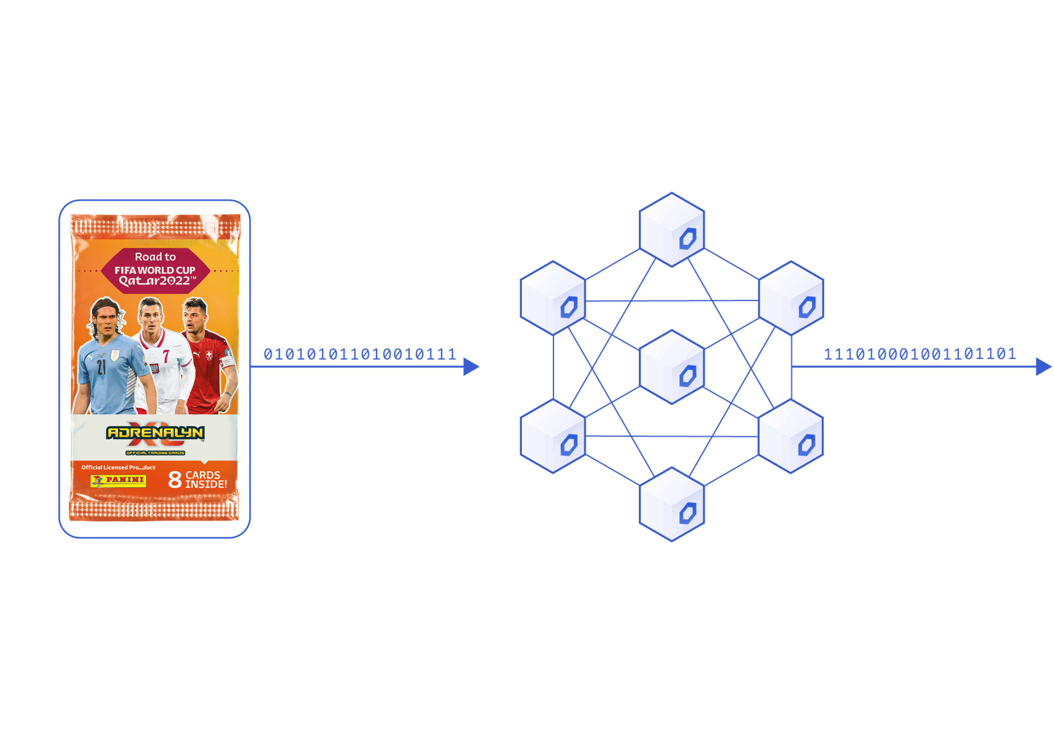
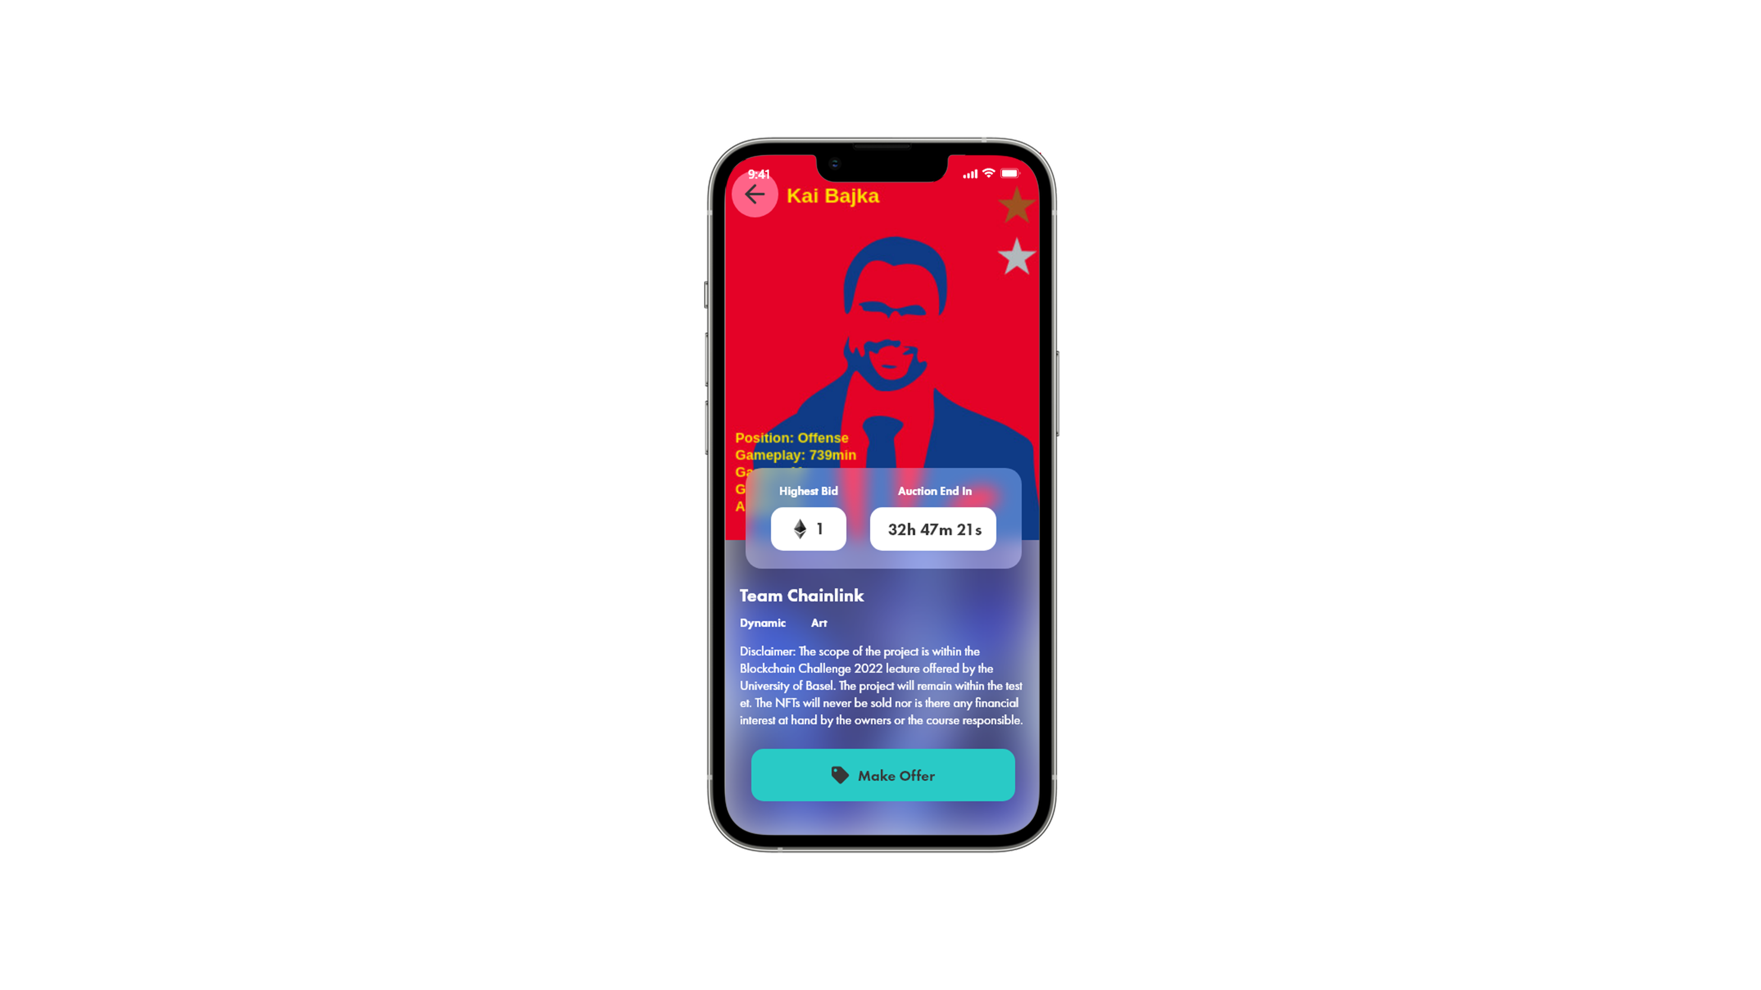
Dynamic NFTs
The next evolution
8

Slide 7
Upgrade Players
7

Slide 8
Minting Process
9
User
Buys random NFT
VRF assigns player
Minted NFT

Slide 9
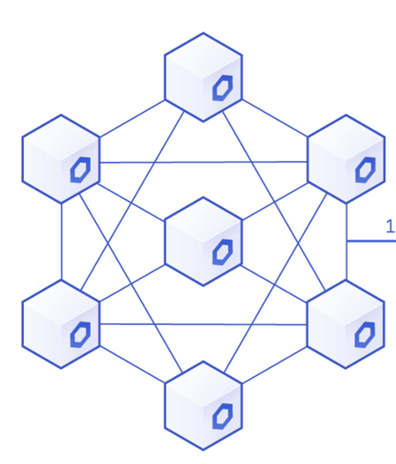
Automatic Updating Trading Cards
10
Oracle
Checks stats & updates them

Slide 10
Raffle
9
Owners
NFT with Personal Score
VRF raffle
Winning NFTs

Slide 11
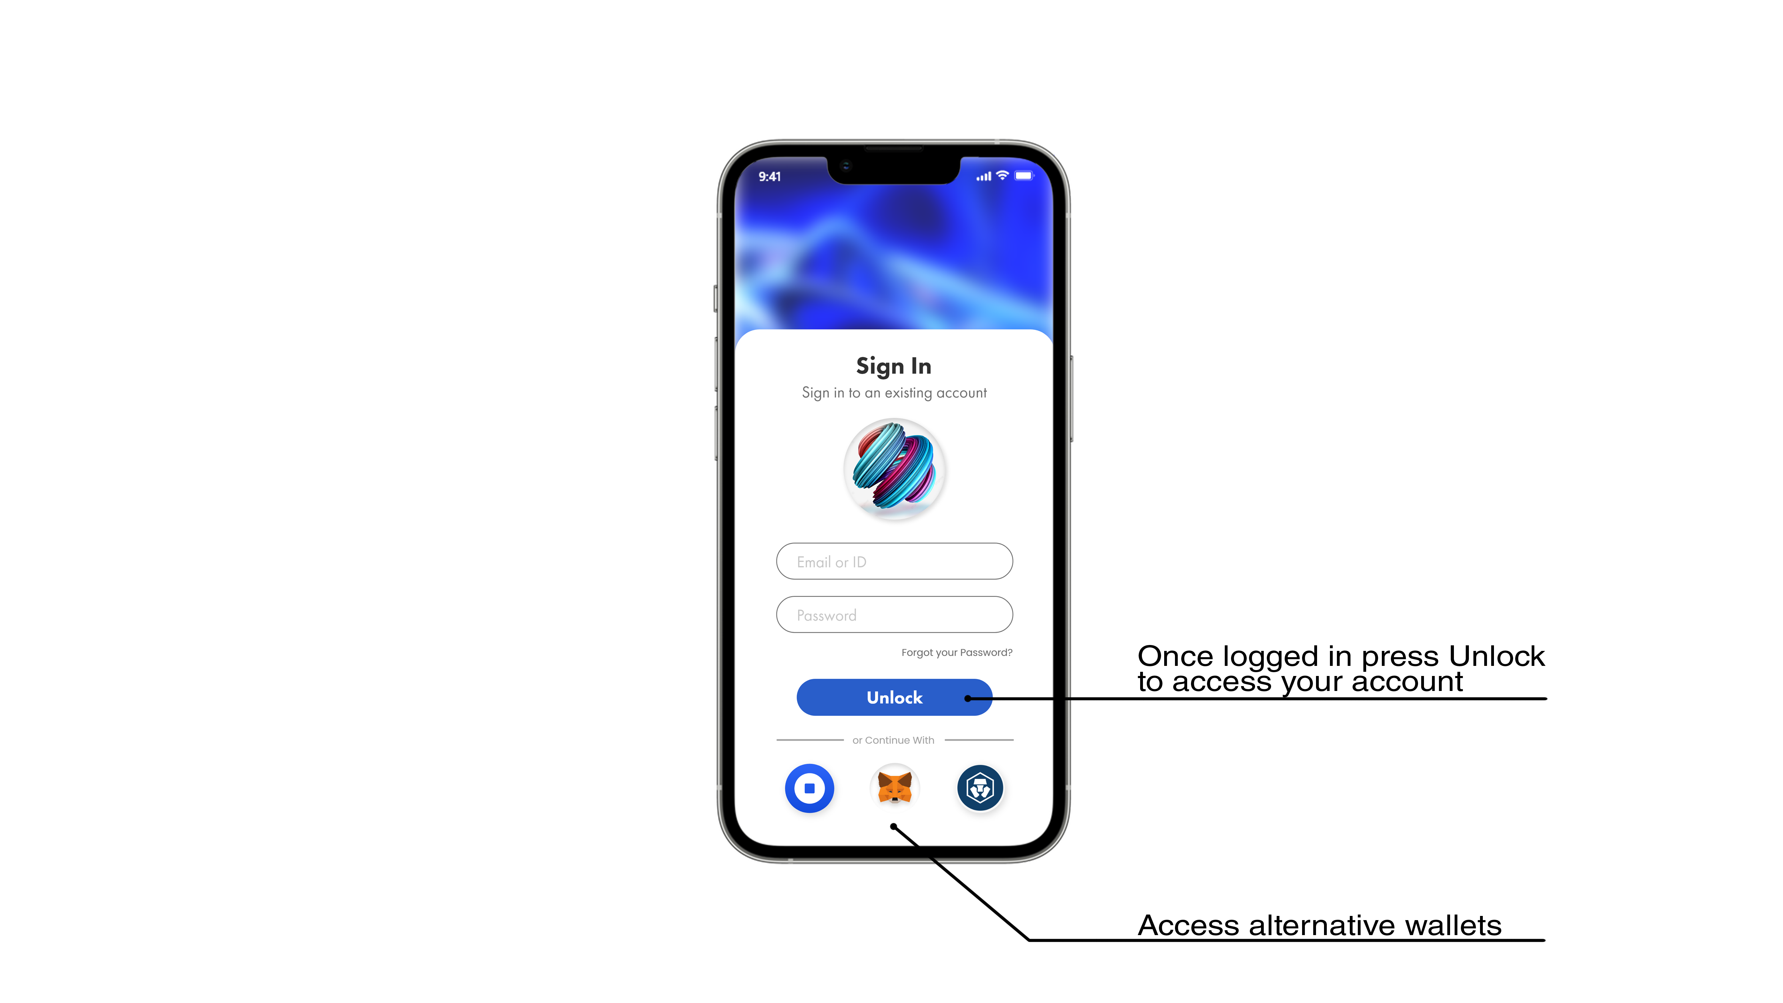
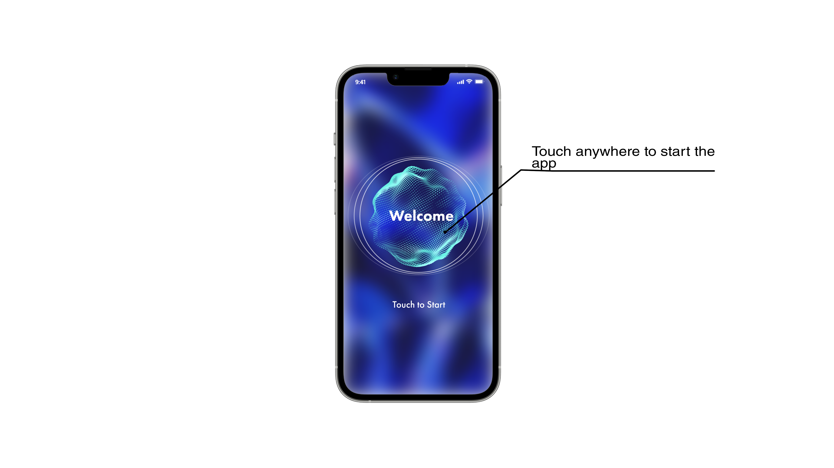
UI/UX
11

Slide 12
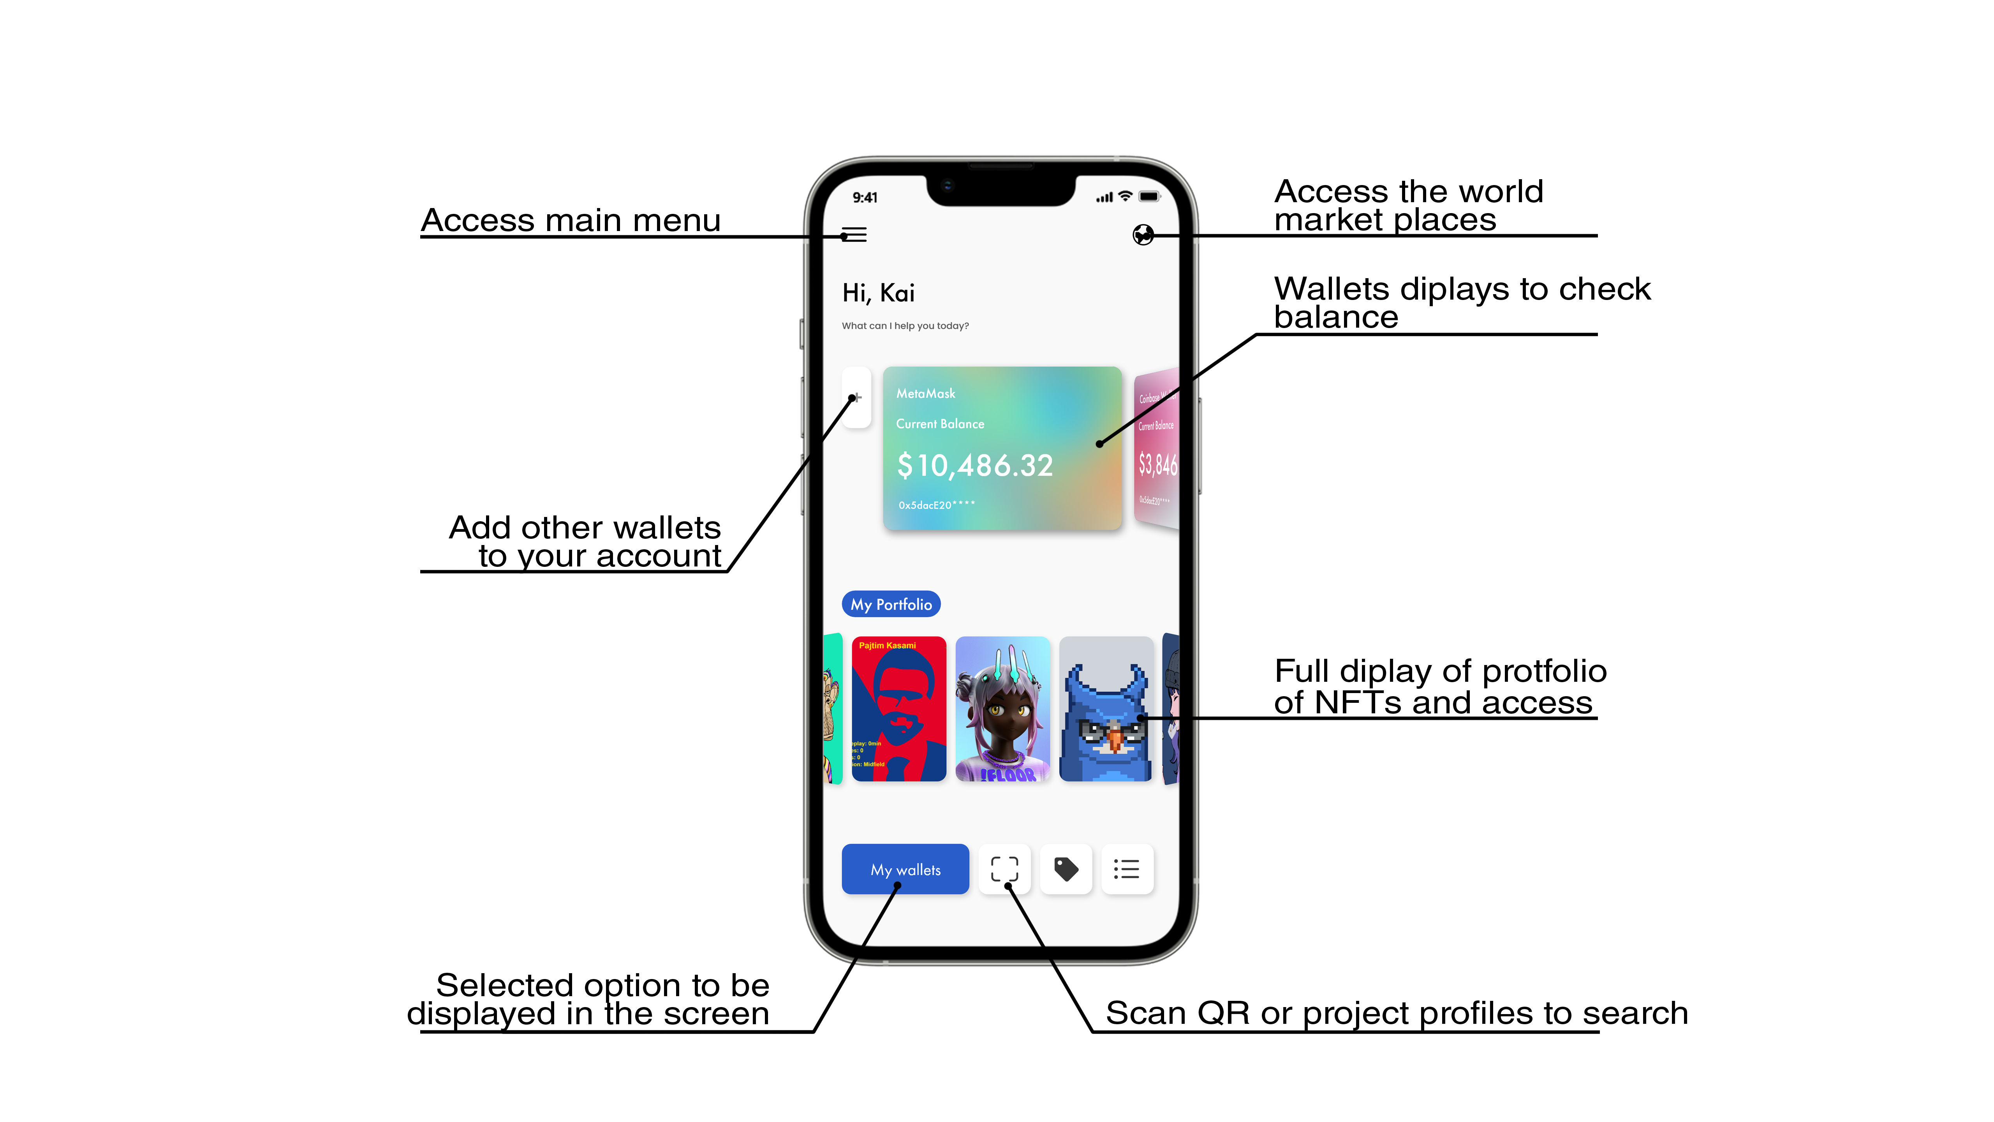
UI/UX
12

Slide 13
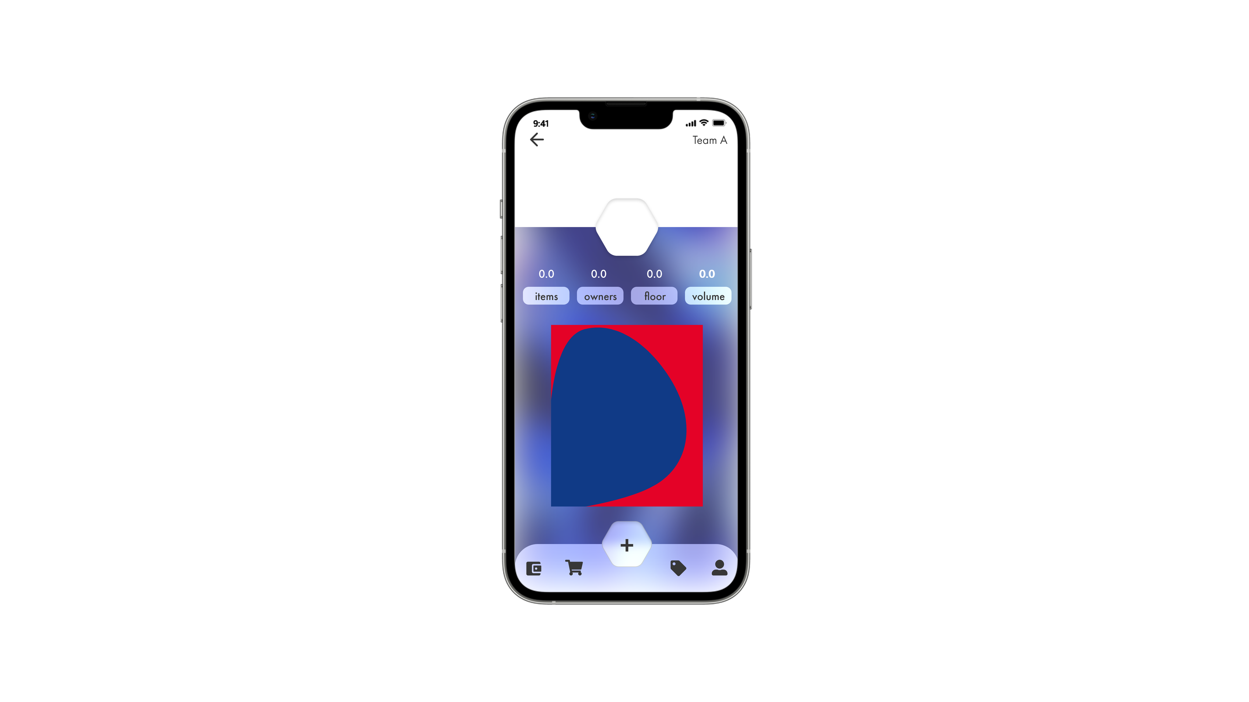
UI/UX
13

Slide 14
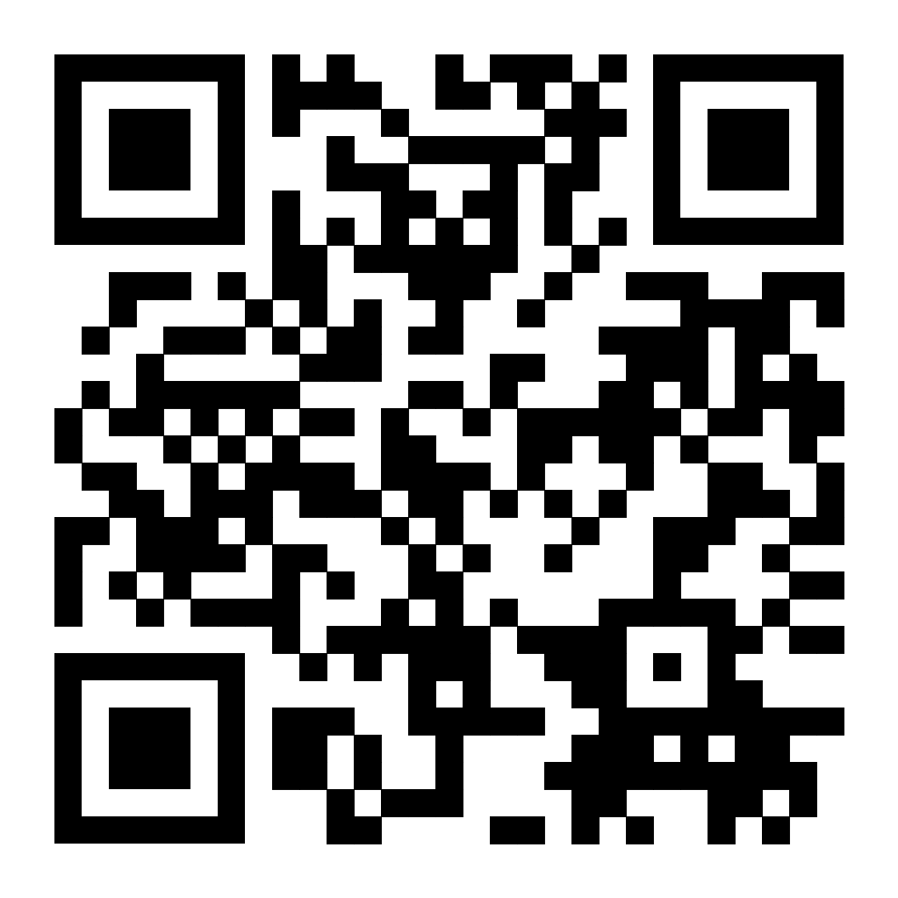
14
Thank You!

